Slide 1
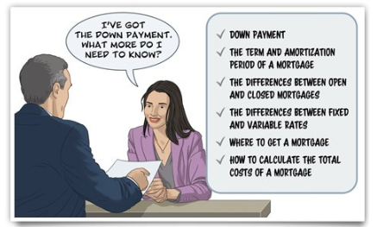
Mortgage basics

Slide 2
topics
What is a mortgage?
Down payment
Pre-approval
Home Buyers Plan
Amortization and term
Types of mortgages
Interest rates
Payment types
Fixed or variable interest rates
Video: Mortgage basics
Quiz: Mortgage terminology
Case study: Mortgage costs
Your mortgage payment
Payment options
Case study: Financing a mortgage
Summary of key messages

Slide 3
Introduction
Most people will need a mortgage when they decide to buy a home. A mortgage is usually a long-term financial commitment, and the choices you make can affect you for many years. This module will show you how mortgages work and the basic choices you will have to make.
You will explore:
Down payments
The term and amortization period of a mortgage
The differences between open and closed mortgages
The differences between fixed and variable rates
Where to get a mortgage
How to calculate the total costs of a mortgage.

Slide 4
Introduction
You'll review the basic conditions and language used to describe mortgages and compare some different kinds of mortgages.
You’ll use simple financial calculators to estimate your eligibility for a mortgage, and to calculate the costs of a mortgage.
By the time you finish this section, you'll be able to estimate the cost you should plan for if you want a mortgage.

Slide 5
What is a mortgage?
A mortgage is a type of loan often used to buy a home or other property. A mortgage allows the lender to take possession of the property if you don't repay the loan on time. The property is the security for the loan. Normally, a mortgage is a large loan and is paid off over many years.
When you get a mortgage loan, you are called the mortgagor. The lender is called the mortgagee.
Under a mortgage, you are responsible for making regular payments to the lender. The payments cover the interest on the loan plus part of the principal (the amount of the loan). Payments may also include property taxes, insurance and similar charges.

Slide 6
What is a mortgage?
When you make a mortgage payment, the lender uses it first to cover the interest. Then anything left goes to the principal and in some cases to taxes and insurance. At the beginning, only a small amount goes to the principal, but gradually more of the payment goes to the principal until it is fully paid off. The part of the property that is paid for—both through the down payment and through your mortgage payments—is called your equity in the property.
TIP:
The key to saving money on your mortgage is to pay off the principal as fast as possible. If you can make extra payments under the terms of your mortgage, the lender will apply them directly to the principal. By reducing the principal, you can save thousands, or even tens of thousands, of dollars in interest charges. But if you have debts with a higher interest rate, such as credit card debts, or other investments that could pay a higher return, you may be better off using your money for those items before making any extra mortgage payments.

Slide 7
Down payment
If you decide to buy a home using a mortgage, you need a down payment. The down payment is the amount of money that you pay up front toward the price of your home (your mortgage loan covers the rest). In Canada, the minimum down payment is 5% for properties up to $500,000, but some lenders may require more. When the purchase price is above $500,000, the minimum down payment is 5% for the first $500,000 and 10% for the remaining portion.
For more information, read How much you need for a down payment by the Financial Consumer Agency of Canada
TIP:
The larger the down payment you pay, the less interest you will pay over the life of the mortgage. Also, if your down payment is 20 percent or more, you won’t have to pay for mortgage default insurance (insurance to protect the lender in case you can’t make the payments), which can be a significant additional cost.
When you plan a deposit for your mortgage, keep in mind the possibility of Pre-approval and the Home Buyers Plan.

Slide 8
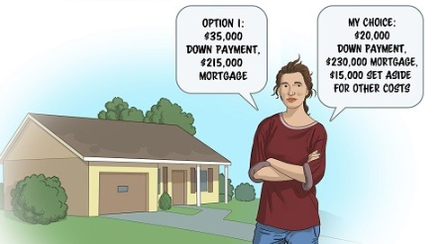
Down payment example
Muriel wants to buy a small house near the packing plant where she works. It’s selling for $250,000, and she has savings of $35,000. The minimum down payment would be $12,500 and she has a good credit history, so she knows she should be eligible for a mortgage. If she puts the whole amount of her savings down, she’ll have a mortgage of $215,000, but no money left for extra costs. However, she decides to keep $15,000 of her savings to cover the costs of buying the home and moving, so she plans to ask for a mortgage of $230,000.
House selling price: $250,000
Muriel's savings: $35,000
Minimum down payment: $12,500
Option 1: $35,000 down payment, $215,000 mortgage
Option 2 (Muriel's choice): $20,000 down payment, $230,000 mortgage, $15,000 set aside for other costs

Slide 9
Pre-approval
Before you start looking at real estate, talk to your financial institution about pre-approving a mortgage. Pre-approval means you talk to a mortgage lender before you need the mortgage to see how much you are qualified to borrow and at what rate. This has several advantages:
It saves time when you make an offer.
It locks in an interest rate for a certain time, usually three months. This means you can get the locked-in rate if interest rates have gone up, but you can still get a lower rate if rates have gone down.
It lets you know how much your financial institution is willing to lend you. But remember: what's important is not how much you can borrow, but how much you can afford to repay.

Slide 10
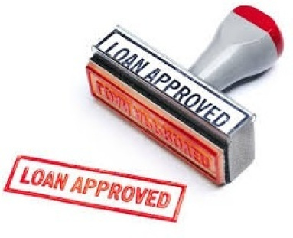
Pre-approval
When you talk to your lender about pre-approval, ask:
How long is the pre-approved rate set for?
Can the pre-approval be extended?
What happens if interest rates go down while I am pre-approved?
Don't rely on a lender to determine what you can afford. Make your own calculations based on your income after taxes and your total expenses. Make sure you have some flexibility so that you can manage other home buying costs, interest rate hikes, maintenance and repair costs, etc.

Slide 11
Home buyers plan
The federal Home Buyers Plan allows first-time buyers to use up to $35,000 from their Registered Retirement Savings Plans (RRSP) to make a down payment. However, you have to pay it back into your RRSP within 15 years, starting from the second year after your withdrawal. If you don't pay it back, you'll have to include it in your taxable income and pay income tax on the amount due. So before using money in your RRSP, be sure you can afford the repayment, plus the payments on your mortgage.

Slide 12
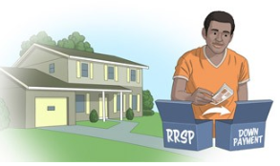
Home buyers plan Example
In 2012, Martin withdraws $6,000 from his RRSP to add to his home down payment. Starting in 2014, he'll have to make payments of $400 a year back to his RRSP ($6,000 ÷ 15 years). If he decides not to make the repayment in 2014, he'll have to include $400 in his income when he files his 2014 income tax return. He'll still have to repay $400 to his RRSP in each of the following years.
To learn more, see the Canada Revenue Agency's information on the Home Buyers Plan.

Slide 13
Amortization and term
Two different words refer to key time periods in a mortgage:
The mortgage term is the length of time that the mortgage agreement at your agreed interest rate is in effect.
The amortization period is the length of time it will take to fully pay off the amount of the mortgage loan.
Mortgage term:
The mortgage term is the length of time your mortgage agreement and interest rate will be in effect (for example, a 25-year mortgage may have a term of five years). However, you don't necessarily pay off the mortgage fully at the end of the term. You may need to renew or renegotiate your mortgage to extend it to a new term and continue making payments.

Slide 14
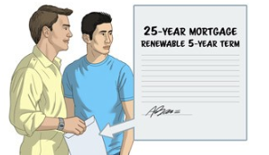
Amortization and term Example
Andrew and Marc want to get a mortgage for $150,000. Their banker suggests a five-year term with a 5.25 percent interest rate. This means that they will make regular payments of principal plus interest for five years. But the $150,000 will not be fully repaid at the end of the term. When the five years are up, they will have to renew the mortgage for a new term at a rate that will then be available. They will be free to look for a better deal from other lenders, but if they choose a different lender, they'll have to pay off the mortgage with the current lender through the arrangement with the new one.
Mortgage amount: $150,000
Term: 5 years
Interest rate: 5.25%
Amortization period: 25 years
Amount remaining to be paid at end of five-year term: $133,277

Slide 15
Amortization and term Example
The term of the contract fixes your agreement for a period of time. Mortgage terms from six months to five years are common, although seven- or ten-year terms are often available. The term simply means that at the end of the period, you will have to negotiate a new mortgage term based on your personal and financial conditions at the time. Usually, your mortgage holder will offer to renew the mortgage at then-current market terms or better. However, it's an opportunity to negotiate with your financial institution or see if you can get a better deal in the market.
When Andrew's and Marc's five-year term ends, their lender offers to renew the mortgage at an interest rate one-quarter point lower than they were paying. They check with other institutions, and find one that offers to renew the mortgage on similar terms for one-half point lower. When they tell their lender that they have a better offer, the lender agrees to match the lower offer in order to keep their business. Andrew and Marc also choose to increase their monthly payments since they have both received a wage increase, and they feel they can afford to pay more on their mortgage every month.

Slide 16
Amortization and term Example
TIP:
A mortgage with a longer term may give you more financial stability because your payments stay the same for the term of the mortgage. It may be especially attractive when interest rates are lower than they normally are.
However, a longer term limits your ability to look for better rates if interest rates go down. In addition, there may be a substantial pre-payment charge if you move and pay off your mortgage before the end of the term, so it's important to carefully consider the term of your mortgage.
A shorter term could help avoid pre-payment charges if you think you may have to end the term early. (See the section on Negotiating a mortgage.)

Slide 17
Amortization period
The amortization period is the length of time it would take to pay off a mortgage in full, based on regular payments at a certain interest rate.
A longer amortization period means you will pay more interest than if you got the same loan with a shorter amortization period. However, the mortgage payments will be lower, so some buyers prefer a longer amortization to make the payments more affordable. Usually, the amortization period is 15, 20 or 25 years. The longest term permitted if you require mortgage insurance is now 25 years.
It's often to your advantage to choose the shortest amortization—that is, the largest mortgage payments—that you can afford. You will pay off your mortgage faster and will save thousands or even tens of thousands of dollars in interest.
An alternative approach is to choose a mortgage that allows you to change your payment each year, double up payments, or make a payment directly on the principal each year. This way, even if you started with a longer amortization period, you can review your financial situation each year and speed up the amortization with extra payments.

Slide 18
Amortization period example
The monthly payments on Andrew's and Marc's $150,000 mortgage would be $894 with a 25-year amortization. The total interest paid over the life of the mortgage would be $118,163. With a 20-year period, their payments would be increased to $1,006, but because they will pay interest for five fewer years, they would pay a total of $91,449 in interest—almost $27,000 less interest in total.

Slide 19
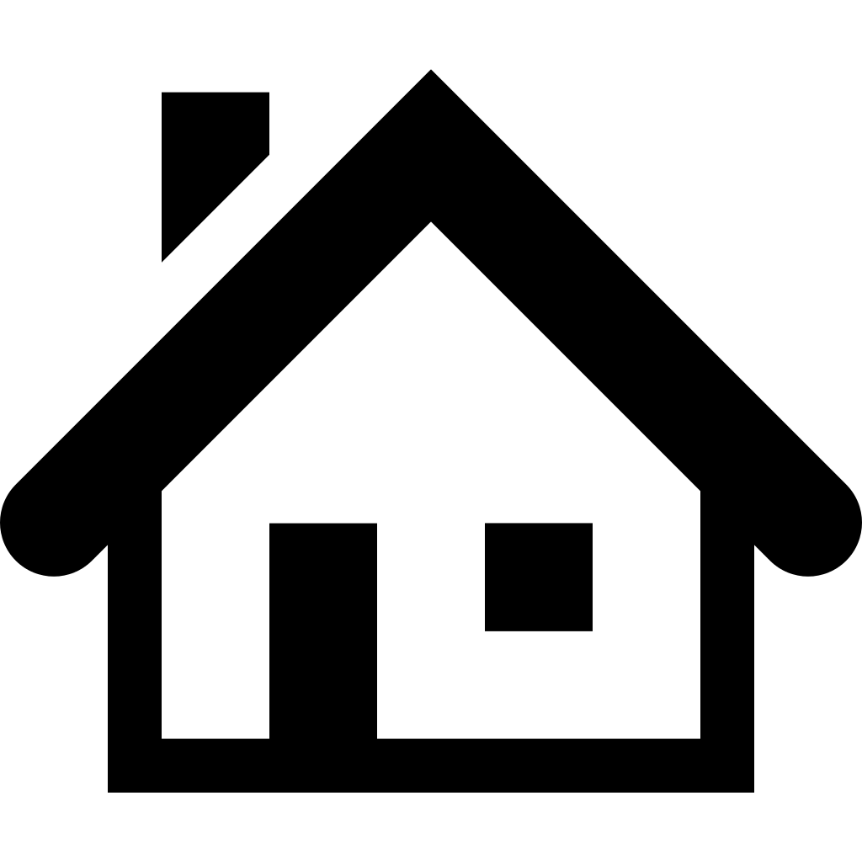
Types of mortgages
Lenders frequently offer two types of mortgages: open and closed. Open mortgages offer more flexibility in making extra payments on the principal or in paying off the mortgage completely.
OPEN MORTGAGES:
With an open mortgage agreement, you can make extra payments (known as prepayments) at any time. You may even be able to pay the mortgage off completely before the end of the term without having to pay any prepayment charges.
The interest rate on an open mortgage is usually higher than on a closed mortgage with similar terms. Open mortgages may be available only for short terms such as six months or a year.

Slide 20
Types of mortgages
CLOSED MORTGAGES:
With a closed mortgage, if you want to change your mortgage agreement during the term (for example, to take advantage of lower interest rates), you will usually have to pay a prepayment charge. The mortgage lender may let you make extra payments (known as prepayments) at any time, without charge but usually with limitations. For example, you may be able to make a 10 percent lump sum payment every year, or increase your scheduled payments by 10 percent. The specific terms will vary from one lender to another.
The interest rate on a closed mortgage is usually lower than the rate on an open mortgage with similar terms.

Slide 21
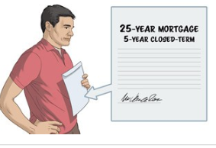
Types of mortgages example
Victor was happy when he signed a five-year, closed-term, $200,000 mortgage because he felt the interest rate was a good one, and he knew it would not change for five years.
After two years, however, he inherited $50,000 from his father. He told his lender that he'd like to use it to pay down his mortgage.
The lender told him that his closed-term mortgage allowed him to prepay only 10 percent of his mortgage amount.
Victor decided to prepay the 10 percent, $20,000, on his mortgage, and to invest the remaining $30,000 until the closed term ended.
He would decide then if he should pay more on the principal before renewing the mortgage.
Mortgage security registration: standard charge or collateral charge
As of September 1, 2014, members of the Canadian Bankers Association​ that offer residential mortgages have committed voluntarily to provide information on mortgage security.

Slide 22
Interest rates
The interest rate you negotiate may be fixed or variable. Each has its own advantages and disadvantages.
FIXED INTEREST RATE:
With a fixed interest rate mortgage, you agree to a certain "fixed" rate of interest in the mortgage contract. This interest rate is set for the entire term, and the amount of your payments is also fixed.
Because the interest rate does not change, you know how much interest you will have to pay and how much of the original loan amount will be paid off during the term. A fixed term gives you security and a predictable budget.
VARIABLE INTEREST RATE:
With a variable interest rate mortgage, the interest rate can change during the term. It is adjusted to reflect market interest rates, which generally follow the Bank of Canada Bank Rate. The Bank Rate varied from 4.75 percent to 0.5 percent between 2005 and 2014.

Slide 23
Interest rates from 2005-2014
The interest rates on variable-rate mortgages are often lower than on fixed interest rate mortgages with the same term length, so variable interest rate mortgages may be attractive and save you interest in the long term. But it's very difficult to predict which will be the lower-cost option over the term of the mortgage.
With a variable-rate mortgage, the mortgage payments can be fixed or variable or a combination of both.

Slide 24
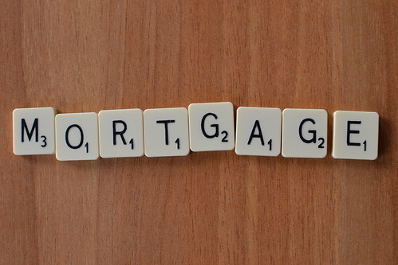
Payment types: fixed and variable
FIXED PAYMENTS:
With fixed payments, you pay one agreed amount with each payment, regardless of changes in the interest rate. If the interest rate goes down, more of the payment applies to the principal and you pay off the mortgage faster. However, if the interest rate goes up, more of the payment applies to interest, and less to the principal. This extends the length of time it will take to pay off your mortgage. You don't know in advance how much of the principal will be paid off at the end of the term.

Slide 25
Payment types: fixed and variable
VARIABLE PAYMENTS:
With variable payments, your payment changes if the interest rate changes. If the interest rate rises, your payments also rise. It's more difficult to plan your mortgage payments over the term of the agreement, so you need to be sure you can adjust your budget to make higher payments. However, the amortization period stays the same. You can tell in advance how much of the mortgage will be paid off at the end of the term, because you pay whatever amount is needed to add up to the agreed amount.

Slide 26
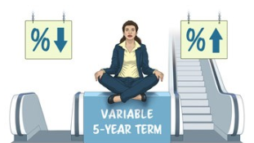
fixed and variable payment example
Marina wants to get a mortgage for $95,000. She arranges for a five-year term at a variable interest rate starting at 4.5 percent. If the rates do not change, she will make monthly payments of $525, and by the end of the term, she will have paid $31,548, including $19,955 in interest and $11,593 on the principal. If she chooses fixed payments, she will still pay $31,548 in total, but more or less of that amount will go to her interest. The amount of principal paid at the end of the term will be more or less than the original calculation. If she chooses variable payments, her total payment and her total interest paid will be more or less than the original calculation. But she will still have paid $11,593 on the principal.

Slide 27
fixed and variable payment example

Slide 28
Convertible, capped & hybrid mortgages
Variable interest rate mortgages may also be convertible. With a convertible mortgage, you can "convert" or change it to a fixed interest rate mortgage during the term. Usually there is no extra charge to do so, but conditions may apply, such as the time when you can make the conversion or the maximum interest rate.
Some variable interest rates can be capped—that is, your lender agrees that the interest rate will not rise above a certain level.
In addition, some lenders offer "hybrid" or combination mortgages—part of the mortgage is financed at a fixed rate and part is financed at a variable rate. This gives you partial protection from rising interest rates, and only partial benefits from falling rates. Hybrid mortgages may be complicated, especially if the two portions have different terms (for example, a two-year term for the variable portion and a three-year term for the fixed portion). They may be difficult to transfer if you negotiate a lower rate with a different lender.
Although these terms can offer more protection against high interest rates, they are usually more costly than a simple variable-rate mortgage. You pay a premium for the increased security.

Slide 29
Factors to consider when choosing…

Slide 30
Fixed or variable interest rate mortgages
Studies have shown that the majority of borrowers with variable-rate mortgages save money in the long term, but that some borrowers pay more. In other words, you can potentially save money, but there is a risk that your interest costs will be higher. In each case, you have to make a choice based on the length of the loan agreement, the current interest rate and the likelihood that the rate will increase or decrease during the life of the loan.
TIP:
Specific mortgage provisions vary from one lender to another. They are explained in the written mortgage agreement, but you can ask the lender to explain exactly how the provisions work. Compare agreements between different lenders to find the best arrangements for your needs.
To review these mortgage terms, see the video Mortgage basics.

Slide 31
Video: mortgage basics

Slide 32
Quiz: mortgage terminology
What's the word?
If you're new to mortgages, many of the words used and the ideas behind them may not be familiar.
You'll feel more confident if you know the basic language and how it's used.
Test yourself by matching the words below with the right meaning.
TO DO:
Screenshot or Snip your results – you must receive 100%.
Click here for Quiz

Slide 33
Case study: mortgage costs
Kemal and Andrea have decided that they need a larger home. They have budgeted their income and expenses, and with their combined incomes they think they can afford payments up to $2,000 a month—enough for a comfortable home for their growing family. But they are not sure what a financial institution will lend them. Kemal suggests that they start with the Mortgage Qualifier Tool from the Financial Consumer Agency of Canada (FCAC).

Slide 34
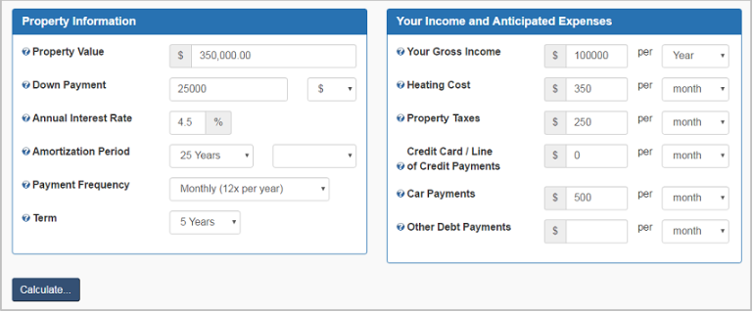
Case study: mortgage costs

Slide 35
Case study: mortgage costs
They have $25,000 saved for a down payment and expect to pay mortgage interest of 4.5 percent with a 25-year amortization period for a five-year term.
Kemal's annual income (before deductions) of $45,000 and Andrea's $55,000 give them an annual income of $100,000 a year.
They expect their monthly property taxes will be about $250 a month, and their heating costs will be about $350 a month.
Their only debt is a car payment of $500 a month.

Slide 36
Case study: mortgage costs
The calculator says that a financial institution would lend them enough for a home priced at $350,000, with their $25,000 down payment and monthly mortgage payments of $1,848. (This includes the cost of mortgage default insurance, added to their payment, because their down payment is less than 20 percent of the house's value.)
"Great. With this information, we'll know how much we could borrow if we need to," Andrea says. Kemal adds, "And our budget tells us the maximum payments we can afford for a new home."
Of course, Kemal and Andrea should aim to spend less than the maximum the calculator shows to give them some flexibility if their finances change. (You will see more about Kemal and Andrea in the next section.)

Slide 37
Case study: mortgage costs
FCAC's Mortgage Qualifier Tool helps you get an idea of the amount you could finance, based on formulas that lenders use to evaluate loans. Together with your income and expenses budget, it can give you a realistic sense of your ability to pay for a mortgage. When you buy a home, you also have to be ready for a variety of additional expenses and taxes. For more information, see the section titled Total costs of a mortgage.
You can estimate the amount of a mortgage you could qualify for with the FCAC's Mortgage Qualifier Tool. Enter the information for a mortgage you'd like to take out. Compare the possible options by choosing different selections from those given and decide which would best suit your needs.

Slide 38
Your mortgage payment
The actual mortgage payment that you will pay depends on several factors, some of which you can influence:
Your down payment is a factor that you can control. If your down payment is less than 20 percent of the price of the house, you'll have to pay mortgage default insurance, a form of insurance that protects the lender if you are unable to repay the mortgage. The lender will usually add the cost of default insurance to your mortgage payments, unless you pay for the insurance separately.
Your credit rating is also a factor you can influence. If you've had a good credit history and don't have other debts, lenders will see that you are not a risky borrower and you might get a better interest rate.

Slide 39
Your mortgage payment
TIP:
Check your credit history every year.
Make sure there are no errors in the file, pay any debts you can and take care of any outstanding credit issues before applying for a mortgage.
See the Credit and debt management module for more information.
Competition between local lenders affects how much they will charge to finance your mortgage.
Check the interest rates other local lenders offer, and negotiate for the best deal that gives you the terms you want. (For negotiating tips, see the section titled Negotiating a mortgage.)

Slide 40
Payment options
Most lenders will let you choose from a variety of payment schedules, such as monthly, biweekly or weekly. If you choose a more frequent schedule, you'll save money, because your money will be applied to the principal sooner, and less interest will accumulate.
If you can afford an "accelerated" schedule, you can make significant savings on your mortgage interest. An accelerated schedule divides your monthly payments over a weekly or biweekly schedule so that you pay an extra monthly payment each year.
The table below shows the main payment schedule options. The example shows payments and the total cost for a mortgage of $100,000 at an interest rate of five percent with an amortization period of 25 years.

Slide 41
Payment options

Slide 42
Payment options

Slide 43
Case study: financing a mortgage
Kemal and Andrea have found a house and made an offer for $364,000—expensive, but they think it's within their budget. Their mortgage lender has agreed to lend them $339,000, the purchase price less their $25,000 down payment, at an interest rate of 4.5 percent. The lender has asked them to review the mortgage documents and choose the payment terms. "This is hard to sort out," Andrea says. "It's hard to choose among all the options," Kemal agrees. They use the Financial Consumer Agency of Canada's Mortgage Calculator to compare them.

Slide 44
Case study: financing a mortgage

Slide 45
Case study: financing a mortgage
With 12 monthly payments of $1,876.27 per year, the calculator shows Kemal and Andrea will have paid $223,881.99 in interest and $339,000 to repay the principal, for a total of $562,881.99 after 25 years.
If they chose a 20-year amortization period, their monthly payments would be $2,137.07—more than they have budgeted. Over the 20-year period, they will pay $173,897.63 in interest, plus the principal, for a total of $512,897.63. With a 20-year amortization period, their payments will be about $261 more per month, but $49,984.36 lower in total—and they'll be debt-free five years sooner. It sounds great, but it's more than the $2,000 they had budgeted. They're not sure they could afford it.
The calculator allows Kemal and Andrea to look at non-monthly payment schedules. For example, they receive their paycheques every two weeks. If they choose an "accelerated biweekly" plan—that is, paying half of the monthly payment every two weeks—their total cost after a 25-year amortization period will be $528,929.30, a saving of $33,952 over the standard 25-year term. That's because their payment is applied to the principal sooner, and they make an extra payment every year by paying on the biweekly schedule.

Slide 46
Case study: financing a mortgage
Kemal and Andrea compare a number of options. They feel that by watching their spending, they can afford the accelerated biweekly payment schedule. "Saving over $33,000 will make up for the difference in our monthly budget," Andrea tells Kemal. And when the five-year term ends, they may be able to afford higher payments to pay off the mortgage faster.

Slide 47
Case study: financing a mortgage
TIP:
Kemal and Andrea are planning to spend most of their money, and they may not have left enough for costs such as mortgage default insurance, taxes, legal costs and moving. These can add several thousand dollars to the cost of a new home. Be sure to check for any extra costs that apply when you consider a mortgage.
Lessons Andrea and Kemal learned:
Online calculators can help you understand and compare the effect of different financial options.
Shorter amortization periods and accelerated payments can significantly cut the interest cost of a mortgage.
Plan for your own mortgage with the Financial Consumer Agency of Canada's Mortgage Calculator and Mortgage Qualifier Tool. Enter the information for your current mortgage, or for a mortgage you expect to take out.
Compare the possible options by choosing different selections from those given and decide which would best suit your needs.

Slide 48
Summary of key messages
When you look for a mortgage, you have to choose:
The amount of the down payment you can pay
The amortization period that will best fit your monthly budget
An open or closed term mortgage
A fixed or variable interest rate
Fixed or variable payments
A monthly, weekly, biweekly or accelerated payment schedule.
The key factor in choosing a mortgage is what you can afford in your monthly budget.
A mortgage calculator will help you compare the costs of different mortgage options.

Slide 49
Action plan
Click here
You will find an Action plan to determine if you’re ready for a mortgage.
This is a tool that you can use to track your progress and take the next steps to manage your mortgage successfully in the future.
Use the action plan as a roadmap for financial action!

